Slide 1
Autonomous Vehicle Development
Center for Intelligent Machines and Robotics
University of Florida

Slide 2
Topics
History
  Autonomous navigation with static obstacles.
  Autonomous navigation in an urban environment.
  Application: Autonomous convoy operations.
  Application: Automated range clearance.
Direction of Research
  Manipulation.
  Vehicle performance.
  New research thrusts.

Slide 3
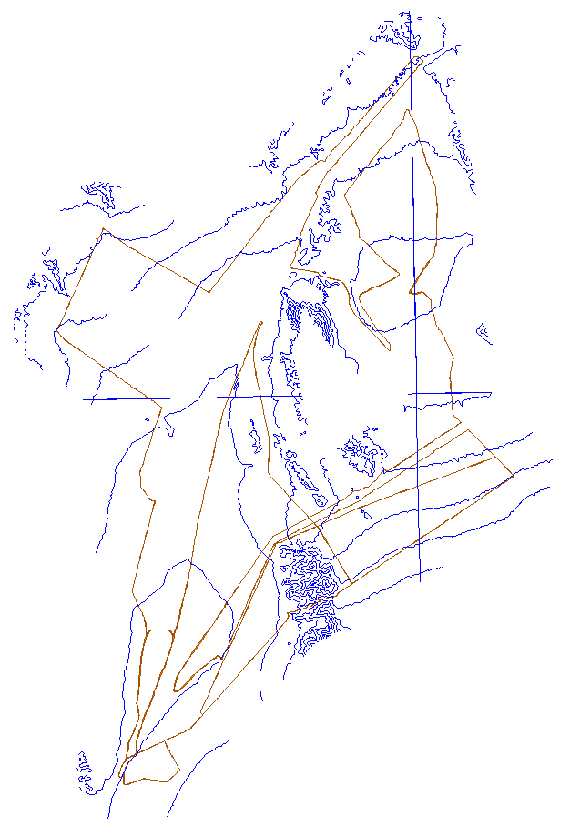
Navigation with Static Obstacles
DARPA Grand Challenge, 2004 & 2005.
Problem Statement
  given: a 225 km path defined by
  a series of waypoints
  navigate the entire path as
  quickly as possible

Slide 4
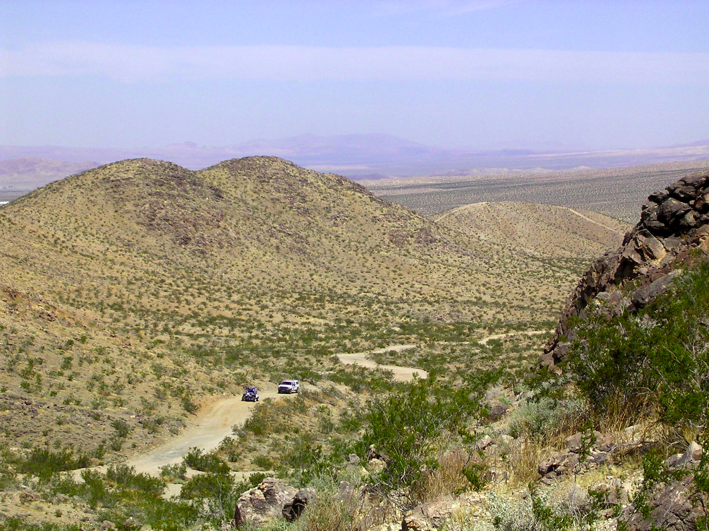

Slide 5
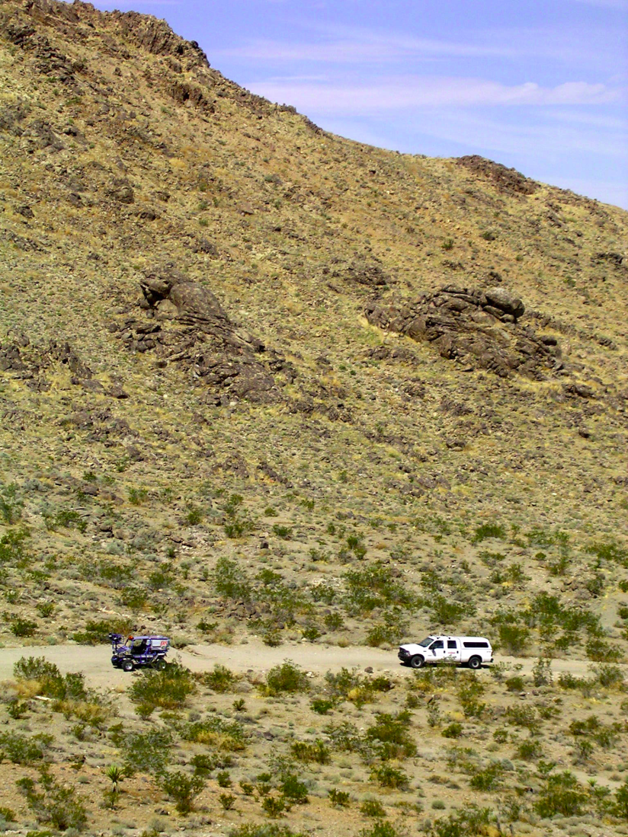
Technical Challenges
off-line path planning
detection of static obstacles
environment data represen-tation and sensor integration
localization
interprocess communication and coordination of multiple threads on multiple computers
reconciliation of differences in estimated global pose, a priori data, and sensed information
fault tolerance

Slide 6
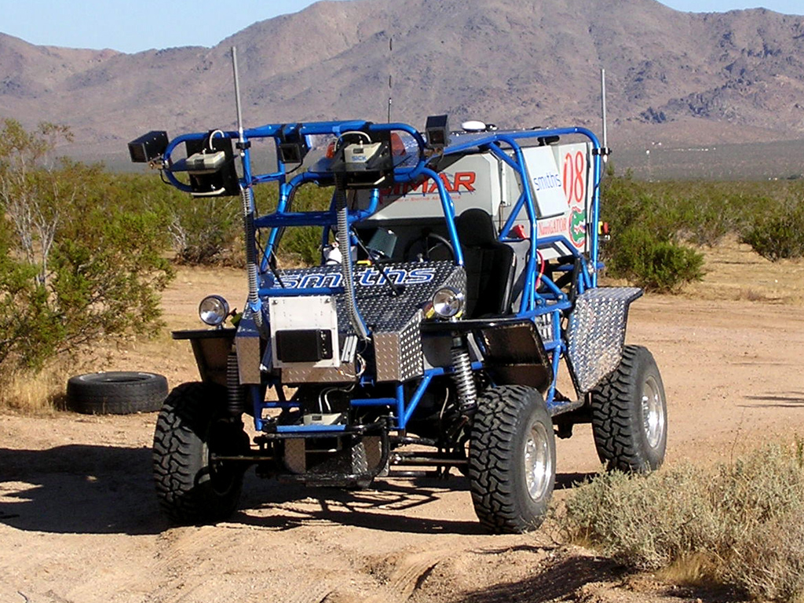
Vehicle System
single primary behavior
  position vehicle in corridor
  locate any obstacles in corridor
  identify best terrain in corridor
  go fast
be ready to run on 27 Sep 05

Slide 7
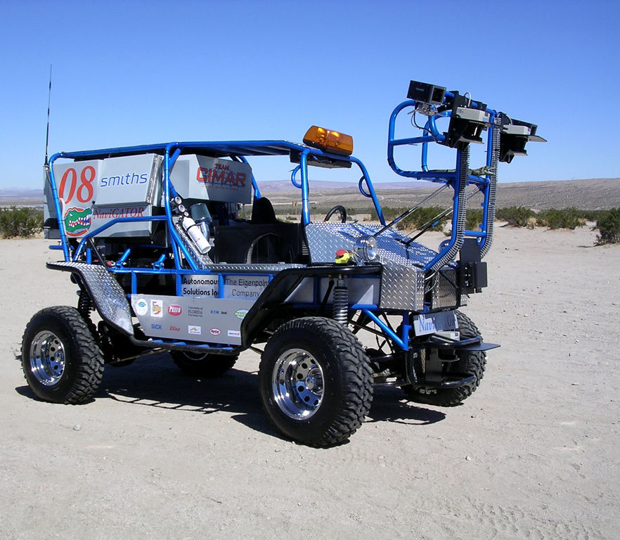
Sensor Systems
design of sensing system
  pose
    Starfire GPS
    Smiths Aerospace IMU
  obstacles
    bumper height ladar
  terrain
    two stationary ladar
    image processing
  implementation of sensor
  arbitration via traversability
  grid
monocular vision
ladar
ladar

Slide 8
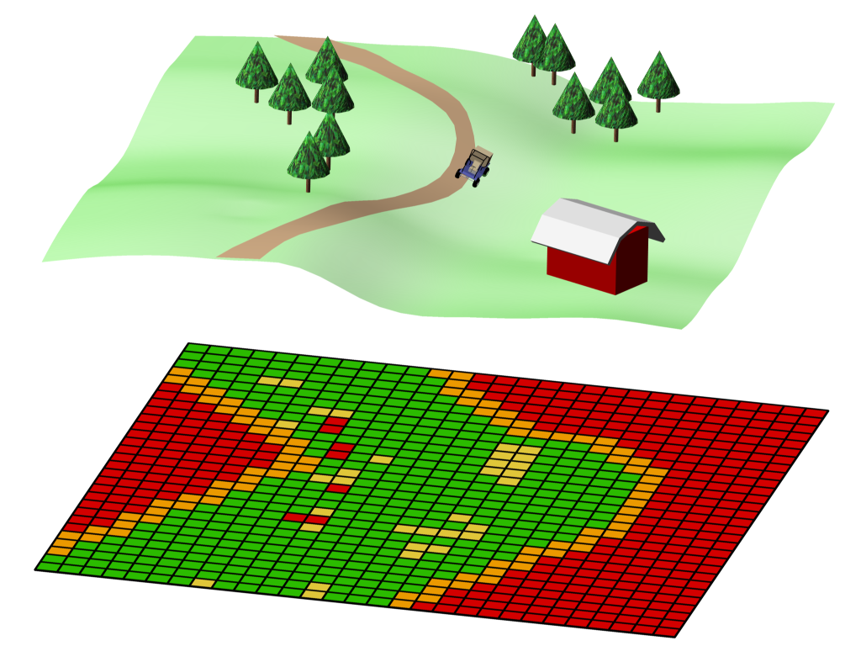

60 m × 60 m grid with
grid resolution of 0.5 m × 0.5 m

Slide 9
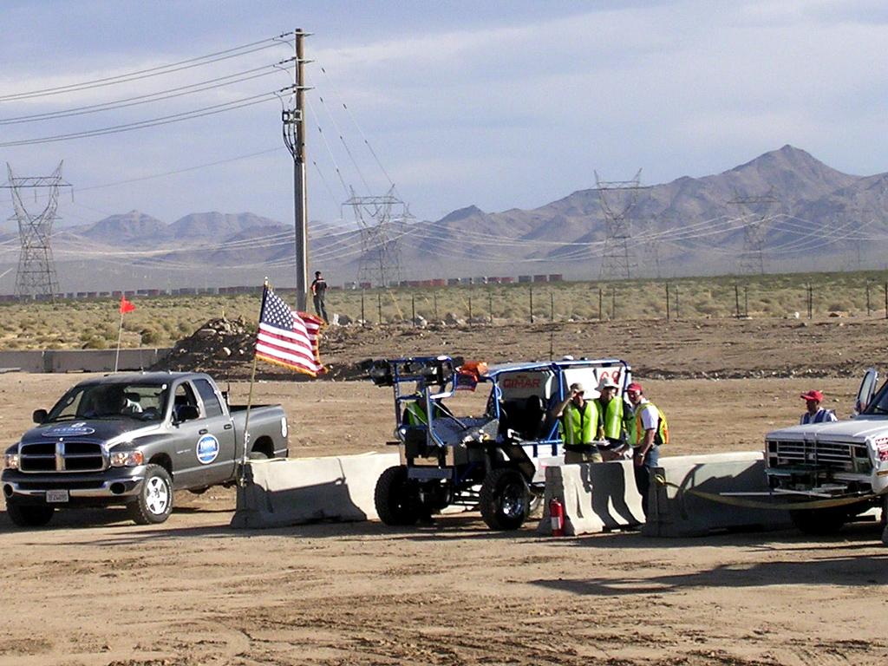

Slide 10
2005 DARPA GC Results
23 vehicles left the starting line
5 vehicles completed the 132 mile course
  Stanford Stanley
  CMU Sandstorm
  CMU Highlander
  Gray Team Kat 5
  Oshgosh Terra Max

Slide 11
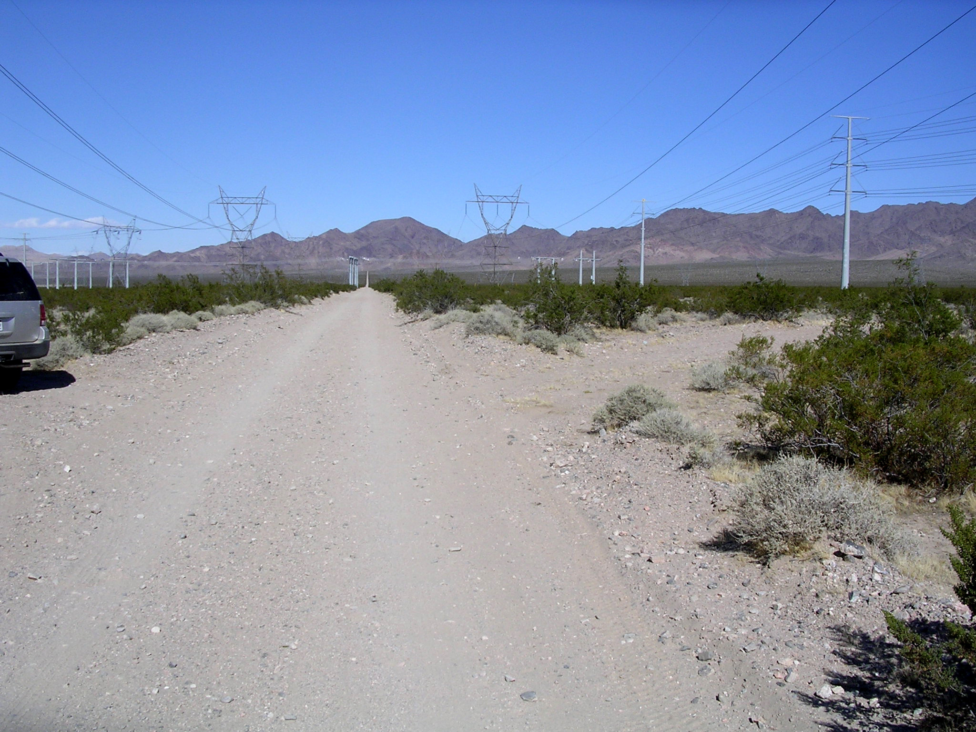
After 14 miles of travel, UF system had an 8 meter error in GPS position (vehicle thought the centerline of the corridor was off to the right).
Upon reaching this road junction, the vehicle moved to the right.

Slide 12

Topics
History
  Autonomous navigation with static obstacles.
  Autonomous navigation in an urban environment.
  Application: Autonomous convoy operations.
  Application: Automated range clearance.
Direction of Research
  Manipulation.
  Vehicle performance.
  New research thrusts.

Slide 13
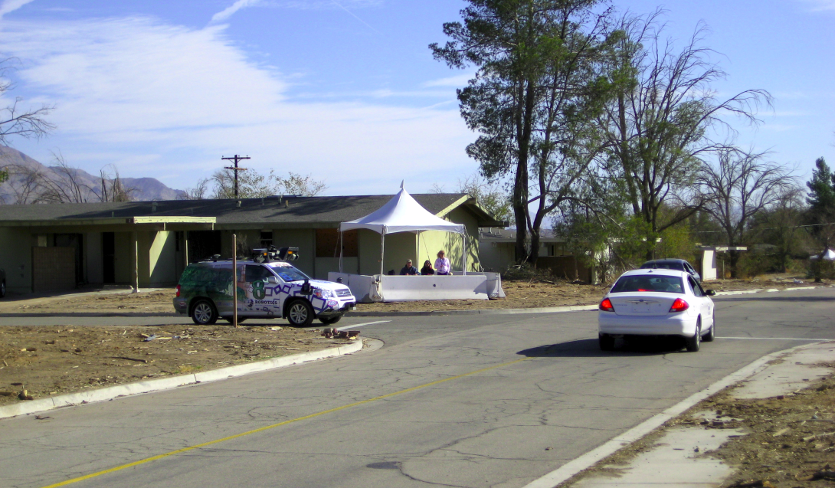
Urban Area Nav. Problem Statement
given:
  Road Network Data File
  Mission Data File
do the following:
  visit the waypoints
  listed in the Mission
  Data File
  obey traffic laws

Slide 14
Sample Road Network Data File (RNDF)
RNDF_name Sample_RNDF_Rev_1.5
num_segments 13
num_zones 1
format_version 1.0
creation_date 29-Mar-07
segment 1
num_lanes 2
segment_name Michigan_Ave
lane 1.1 /*no exits, passing lane*/
num_waypoints 4
lane_width 12
left_boundary double_yellow
right_boundary broken_white
1.1.1 38.875413 -77.205045
1.1.2 38.875471 -77.204189
1.1.3 38.875585 -77.202593
1.1.4 38.875673 -77.201373
end_lane
lane 1.2
num_waypoints 6
lane_width 12
left_boundary broken_white
exit 1.2.4 3.1.1
exit 1.2.6 4.1.1
1.2.1 38.875343 -77.205619
1.2.2 38.875438 -77.204198
1.2.3 38.875528 -77.202959
1.2.4 38.875602 -77.201871
1.2.5 38.875616 -77.201664
1.2.6 38.875676 -77.200830
end_lane
end_segment

Slide 15
Sample Mission Data File (MDF)
MDF_name Sample_MDF_Rev_1.5
RNDF Sample_RNDF_Rev_1.5
format_version 1.0
creation_date 30-Jan-07
checkpoints
num_checkpoints 18
1
2
3
2
3
2
3
4
2
4
2
14 /*parking spot*/
5
10
17 /*parking spot*/
6
7
8
end_checkpoints

Slide 16
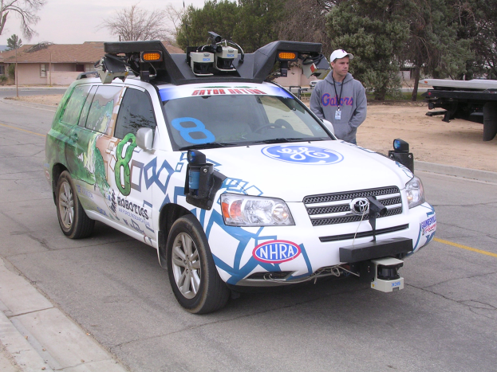
2007 Urban Challenge
Basic Navigation
  stay in lane
  passing
  U turn
Basic Traffic
  intersections
  minimum following distance
Advanced Navigation
  obstacle field
  parking lot
  dynamic replanning
  road following
  GPS outage
Advanced Traffic
  merging
  left turn in traffic
  defensive driving
  traffic jams
3 Nov 2007

Slide 17
Basic Navigation

Slide 18
Basic Navigation

Slide 20
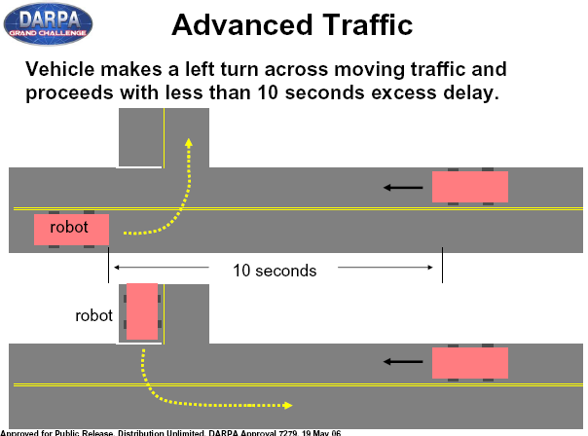

Slide 21
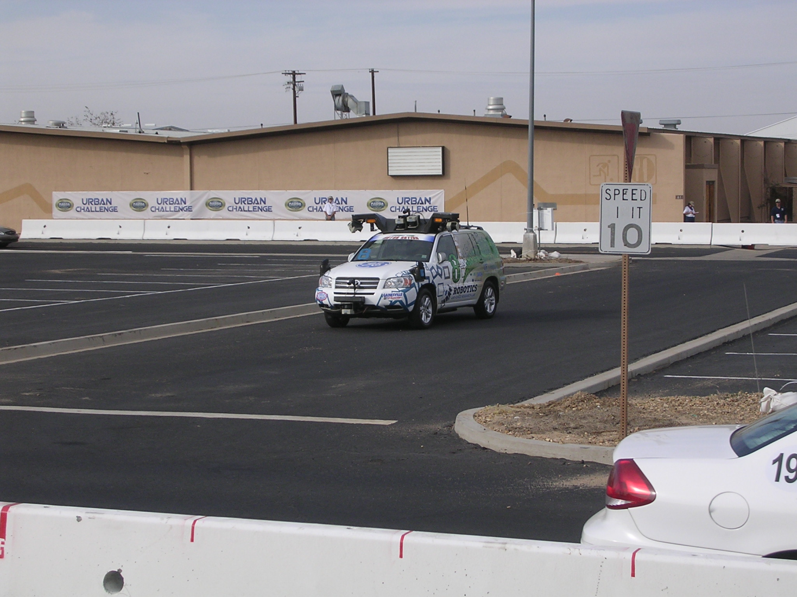
New Technical Challenges
pavement (road) detection and lane detection
detection and classification of dynamic objects
reconciliation of differences in estimated global pose, a priori data, and sensed information
determination of appropriate behavior mode
smooth transition of vehicle control between behavior modes

Slide 22
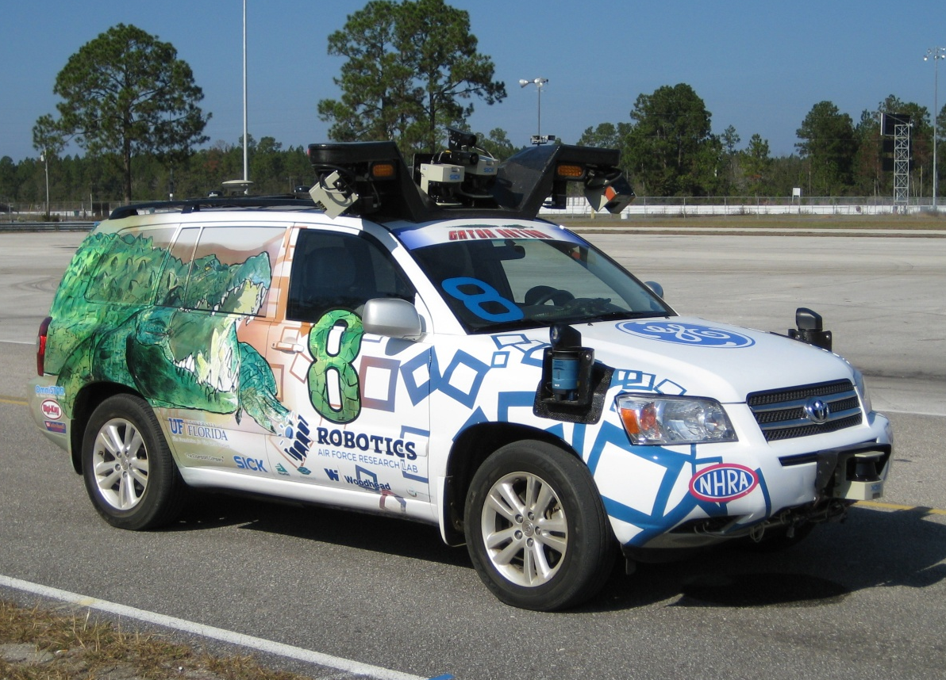
Urban NaviGator
Hybrid Toyota Highlander
Sensors
  Smiths NFM integrated with Novatel and Garmin GPS and wheel encoders
  6 Sick ladars
  2 long range Sick ladars
  6 Bluefox cameras

Slide 23
High Level of Complexity
6 primary behavior modes
  roadway navigation behavior
  open area navigation behavior
  parking lot behavior
  n-point turn behavior
  intersection behavior
  passing maneuver behavior
UF team developed and implemented the Adaptive Planning Framework
  decides upon the best current behavior mode

Slide 24
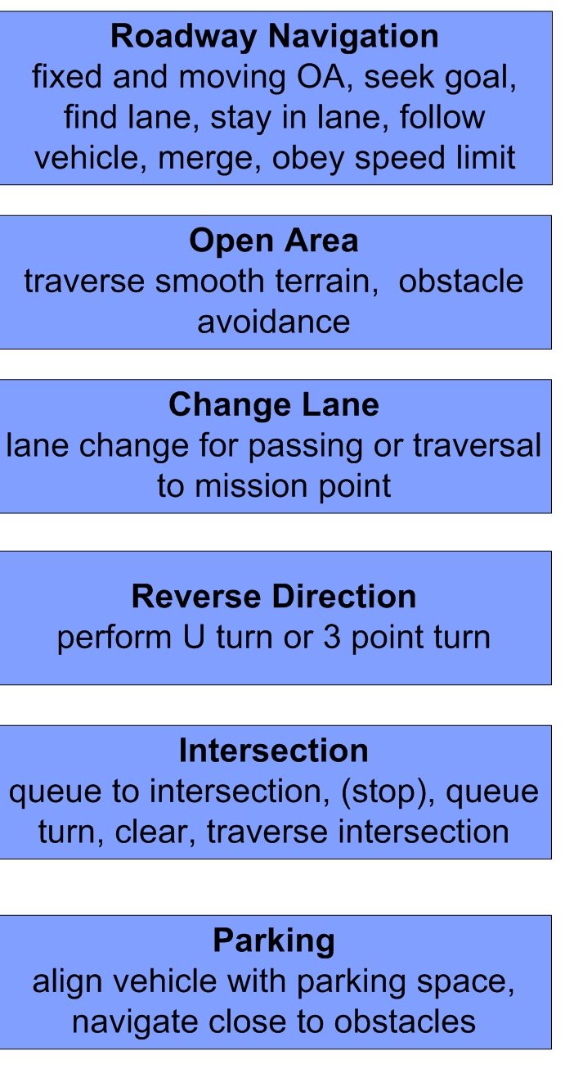
EVALUATE
BEHAVIORS
FINDINGS
SELECT
BEHAVIOR

Slide 26
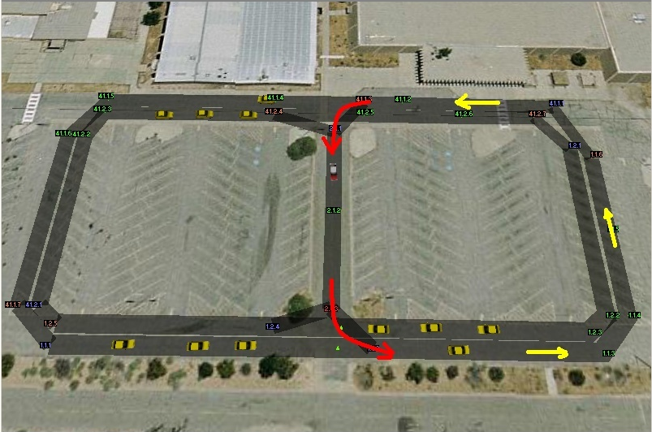
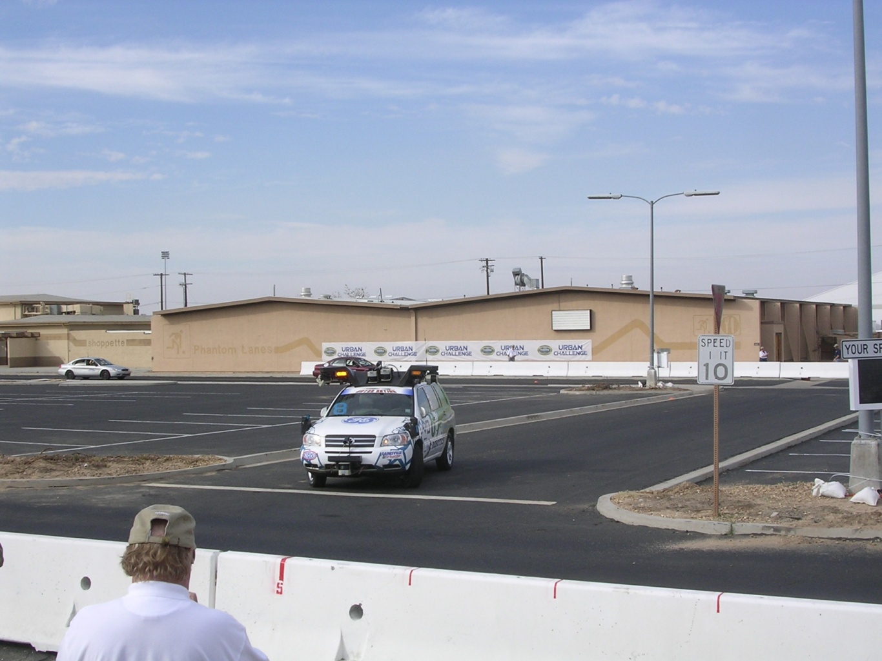
Test Area A
tested moving obstacles

Slide 27
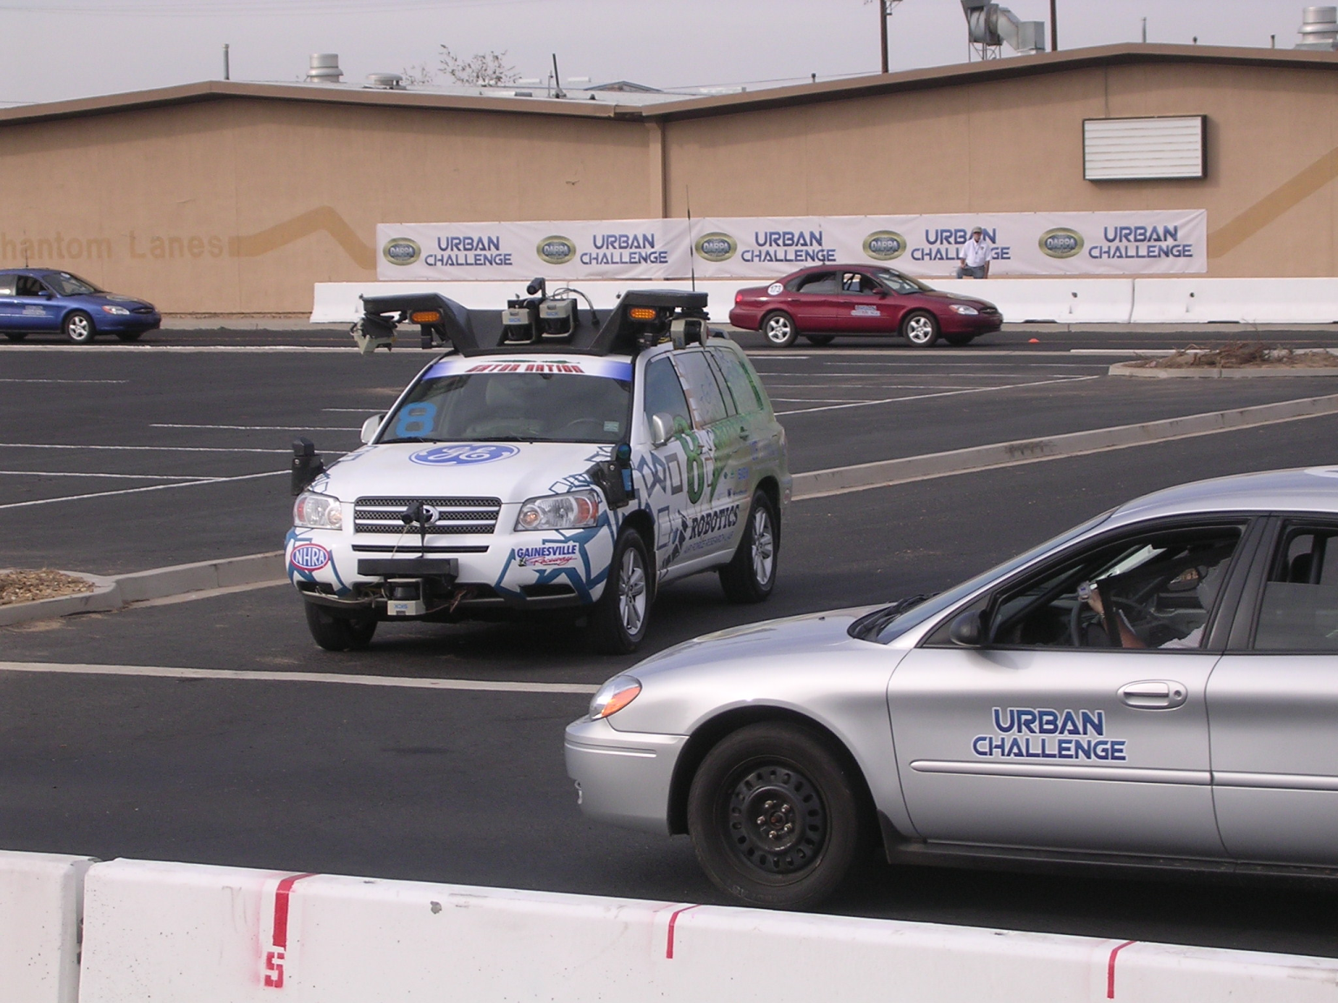
Test Area A

Slide 28
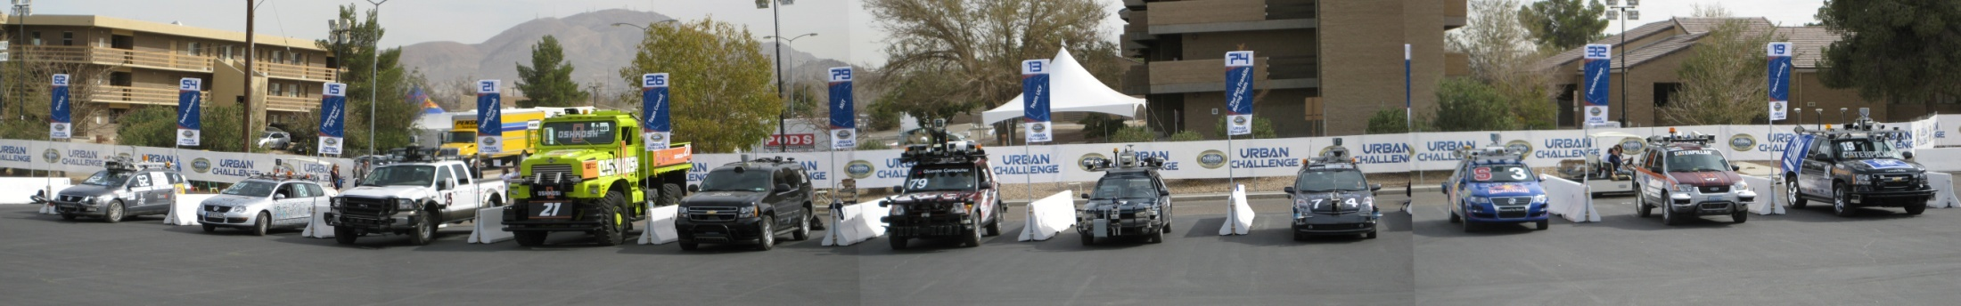
Finals
11 Teams Selected
Karlsruhe
Oshkosh
MIT
Penn
VT
Braun-
schweig
Honeywell
Cornell
UCF
Stanford
CMU

Slide 29
Topics
History
  Autonomous navigation with static obstacles.
  Autonomous navigation in an urban environment.
  Application: Autonomous convoy operations.
  Application: Automated range clearance.
Direction of Research
  Manipulation.
  Vehicle performance.
  New research thrusts.

Slide 30
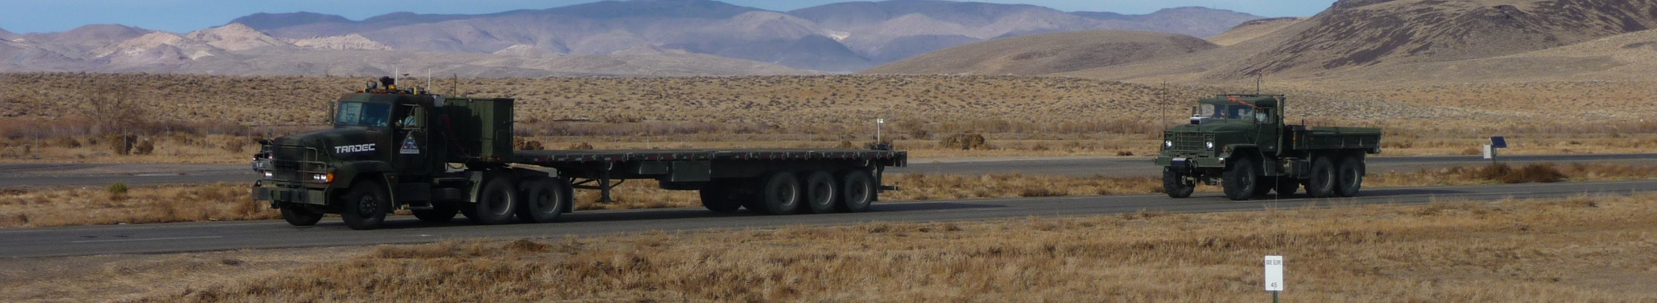
Convoy Operations - Important Points
Human driven leader vehicle.
Automated follower vehicle.
Design Constraints
  No radio communication between any vehicle
  No GPS on any vehicle

Slide 31
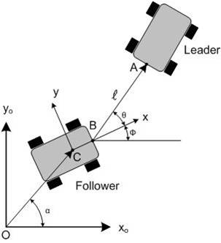
Controller

Slide 32

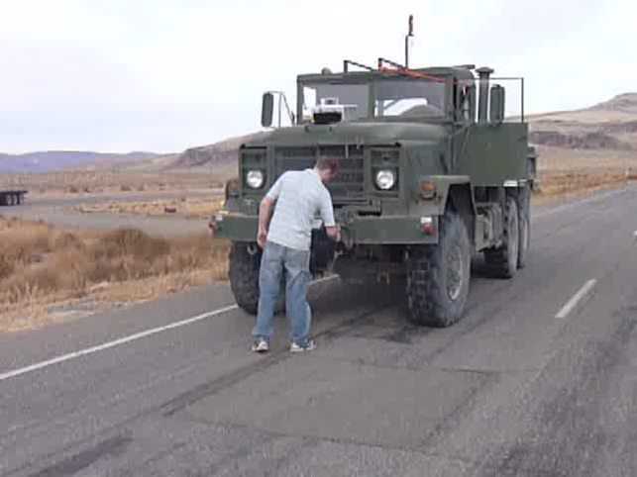
Tether Approach

Slide 33
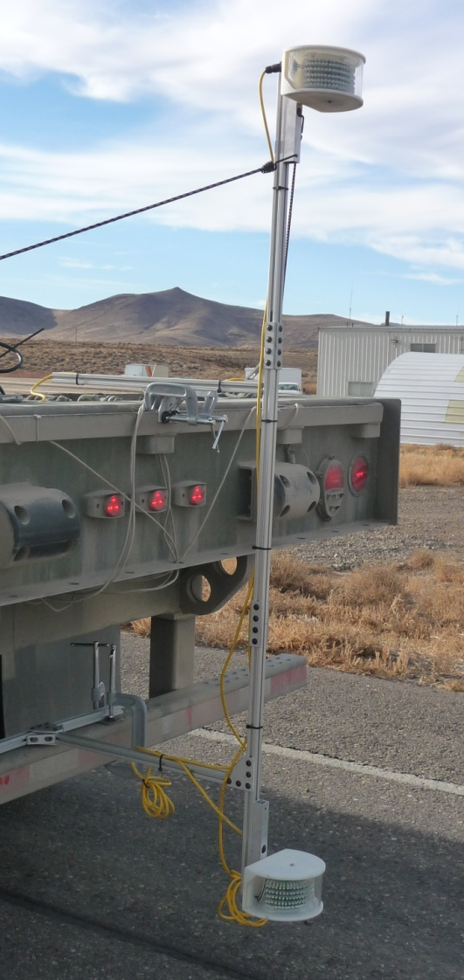
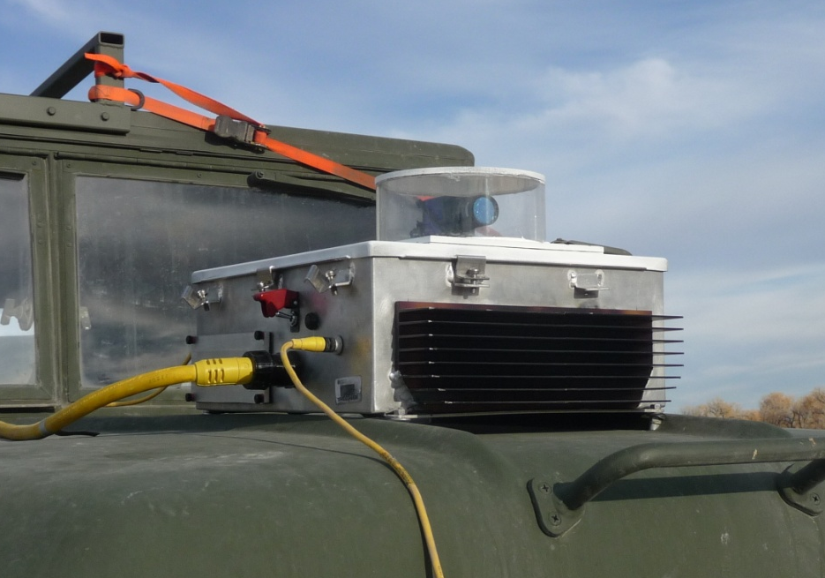
Vision approach
  infrared emitters attached to back of leader vehicle
  panning camera mounted on follower
  measures distance and angle to leader
  (exact same data as obtained by tether)

Slide 34
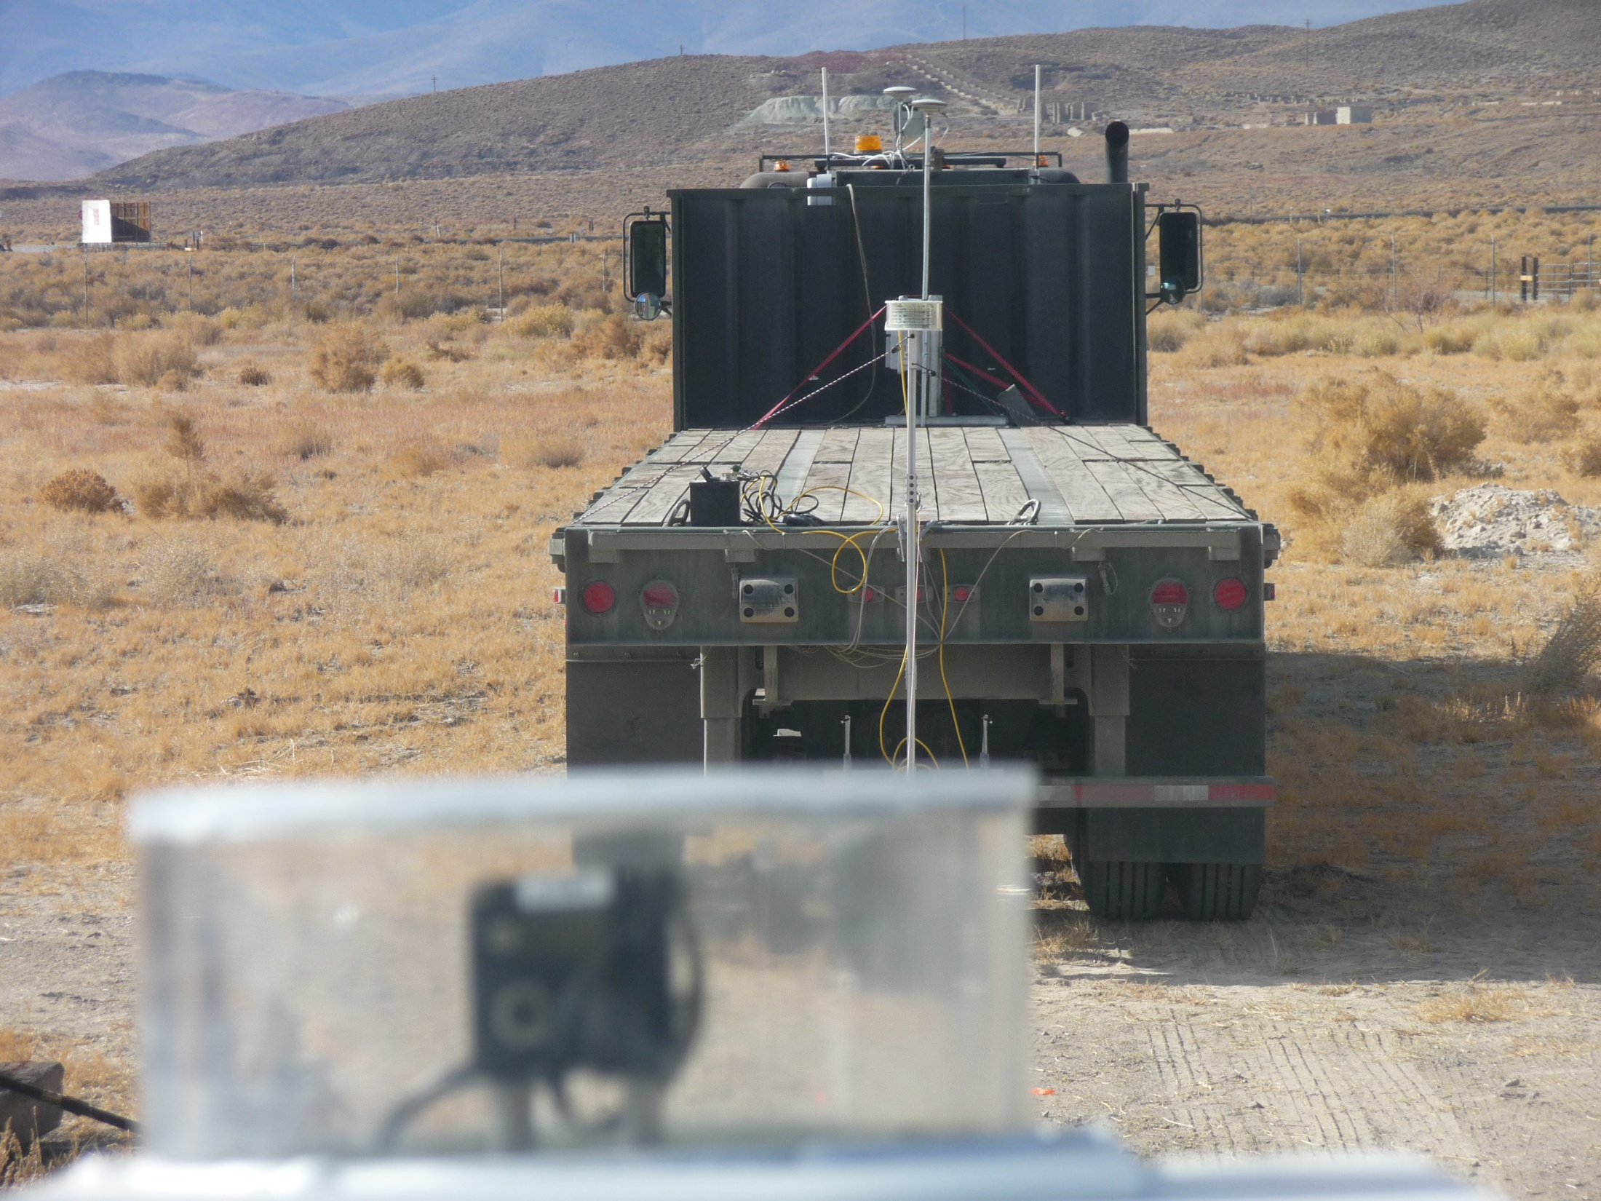

Slide 35
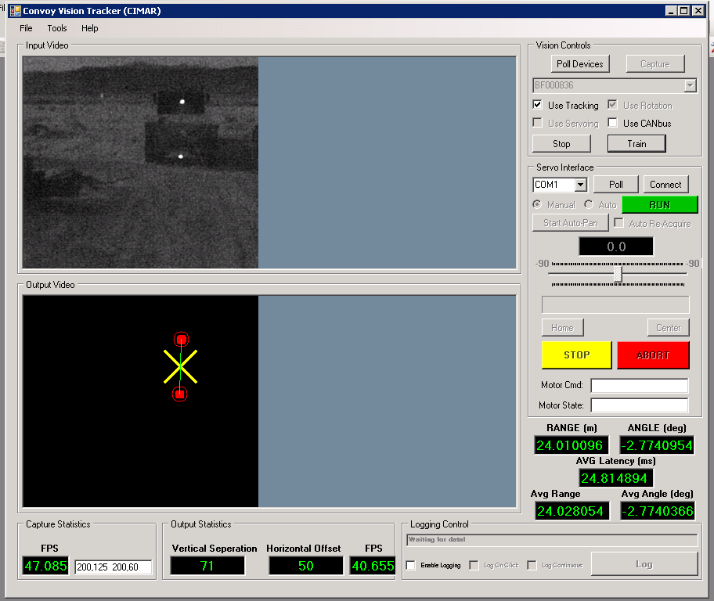

Slide 36
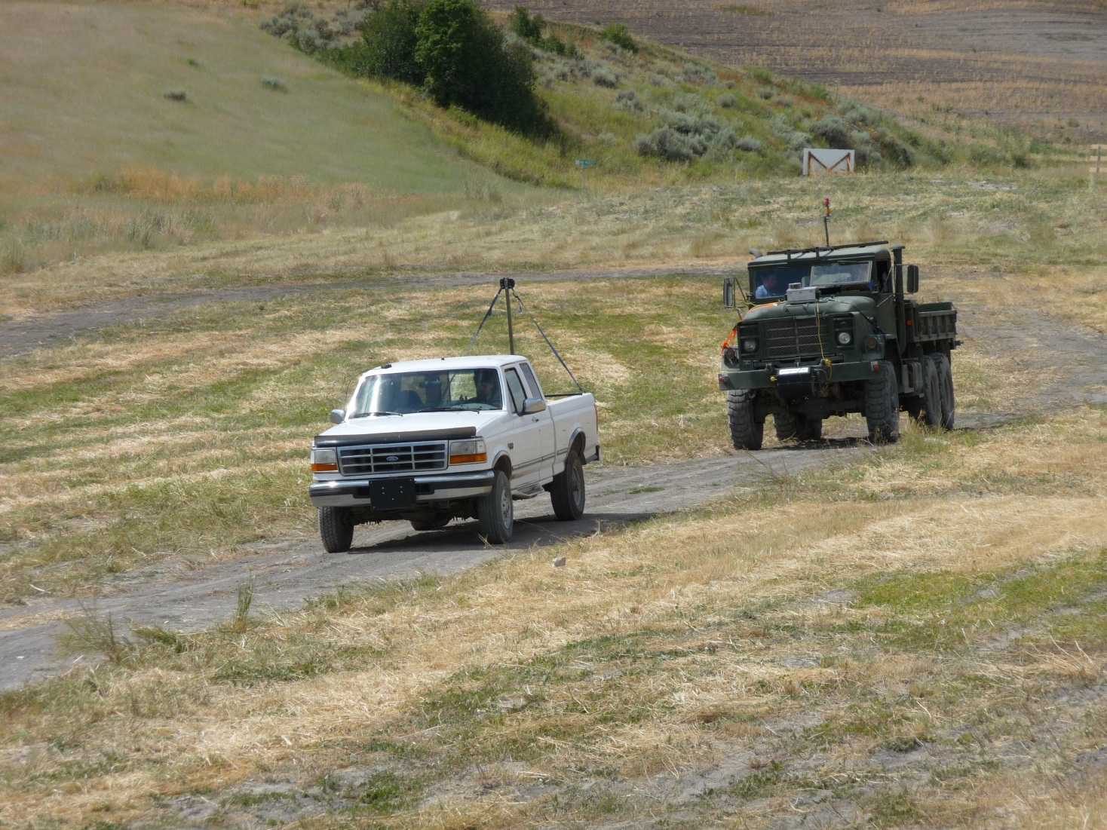
Vision Sensor

Slide 37
Topics
History
  Autonomous navigation with static obstacles.
  Autonomous navigation in an urban environment.
  Application: Autonomous convoy operations.
  Application: Automated range clearance.
Direction of Research
  Manipulation.
  Vehicle performance.
  New research thrusts.

Slide 38
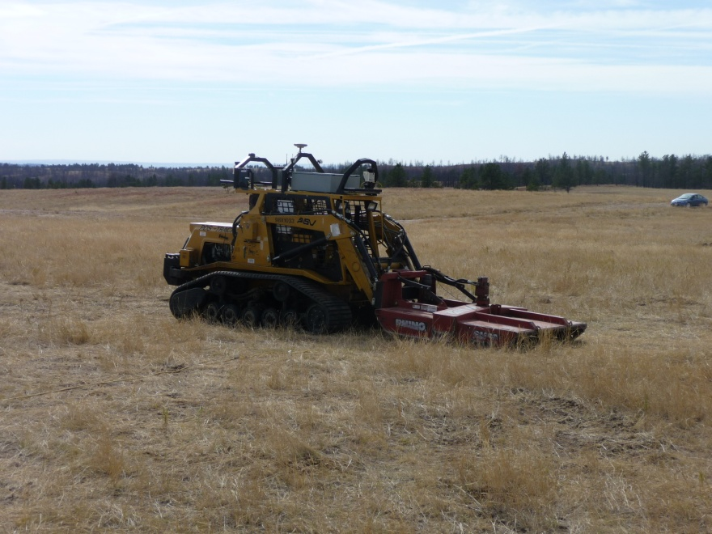
Autonomous Range Clearance
Four steps
    vegetation removal

Slide 39
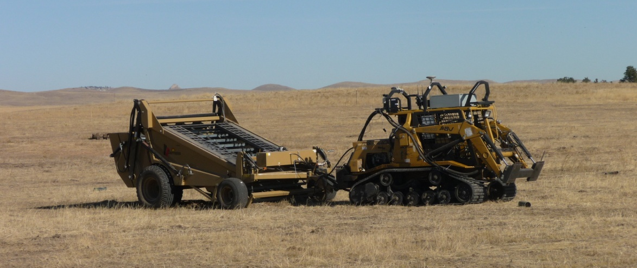
Autonomous Range Clearance
Four steps
    vegetation removal
    surface object removal

Slide 40
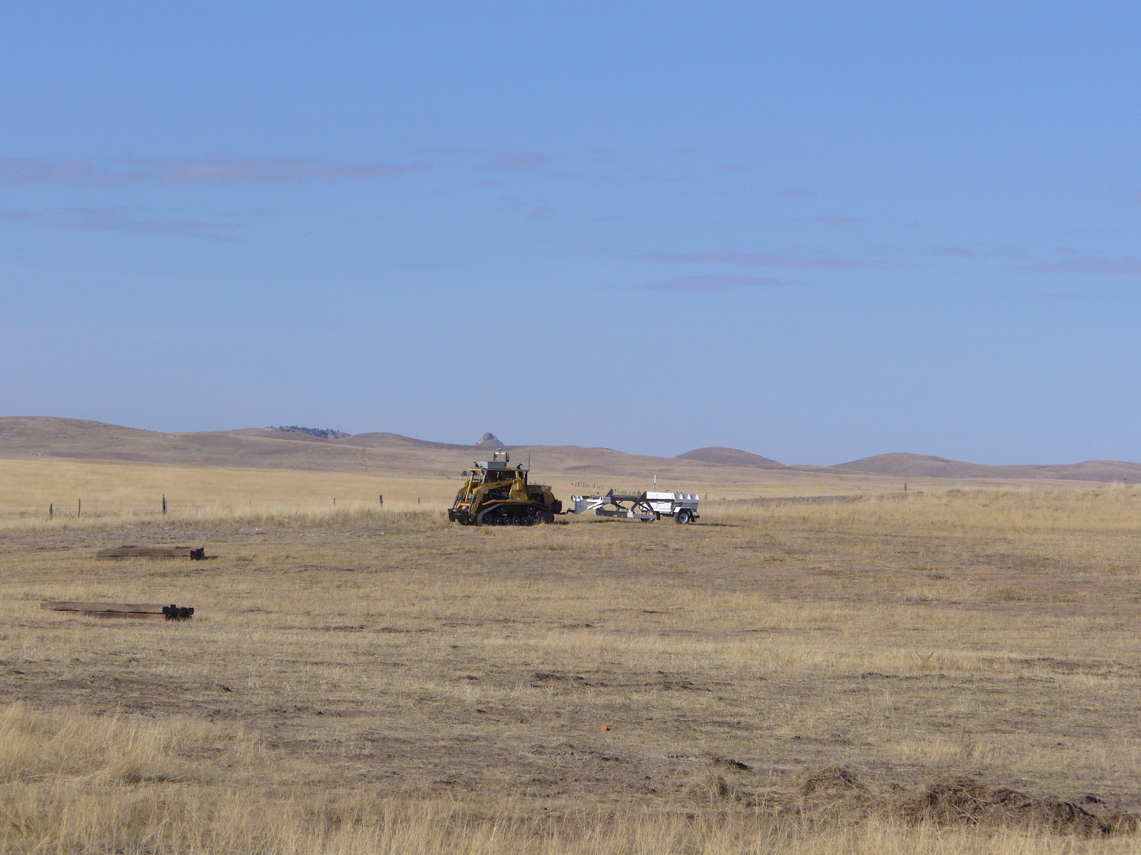
Autonomous Range Clearance
Four steps
    vegetation removal
    surface object removal
    mapping of subsurface objects

Slide 41
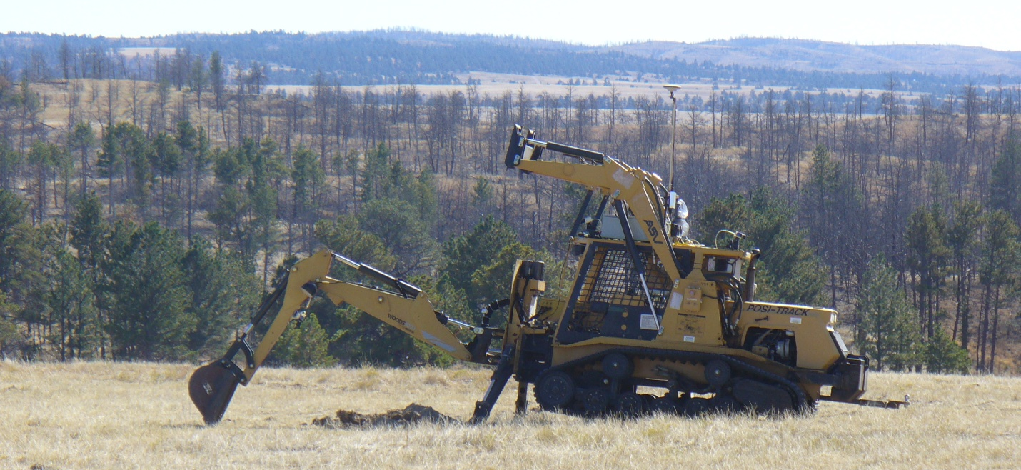
Autonomous Range Clearance
Four steps
    vegetation removal
    surface object removal
    mapping of subsurface objects
    digging and removal of subsurface objects

Slide 42
Topics
History
  Autonomous navigation with static obstacles.
  Autonomous navigation in an urban environment.
  Application: Autonomous convoy operations.
  Application: Automated range clearance.
Direction of Research
  Manipulation.
  Vehicle performance.
  New research thrusts.

Slide 43
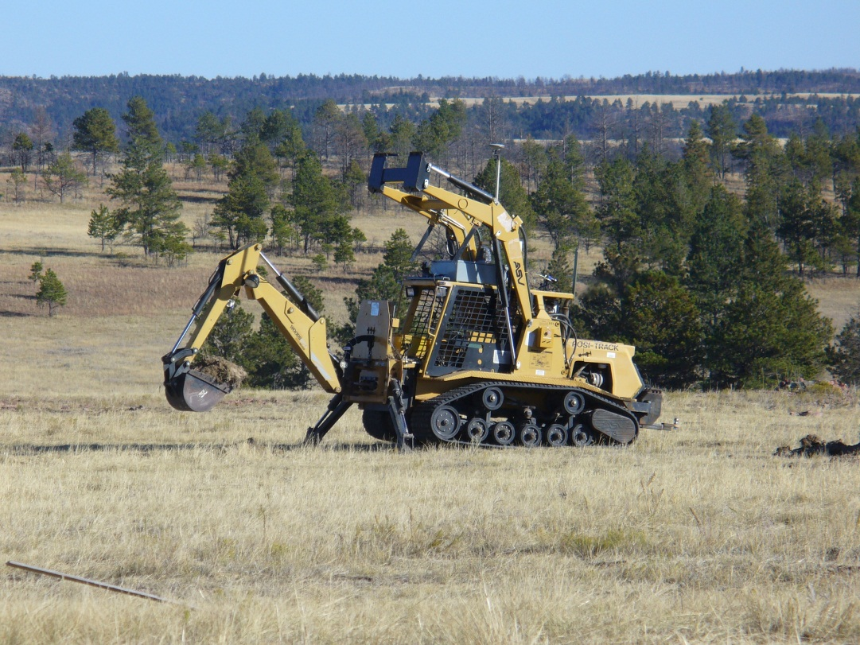
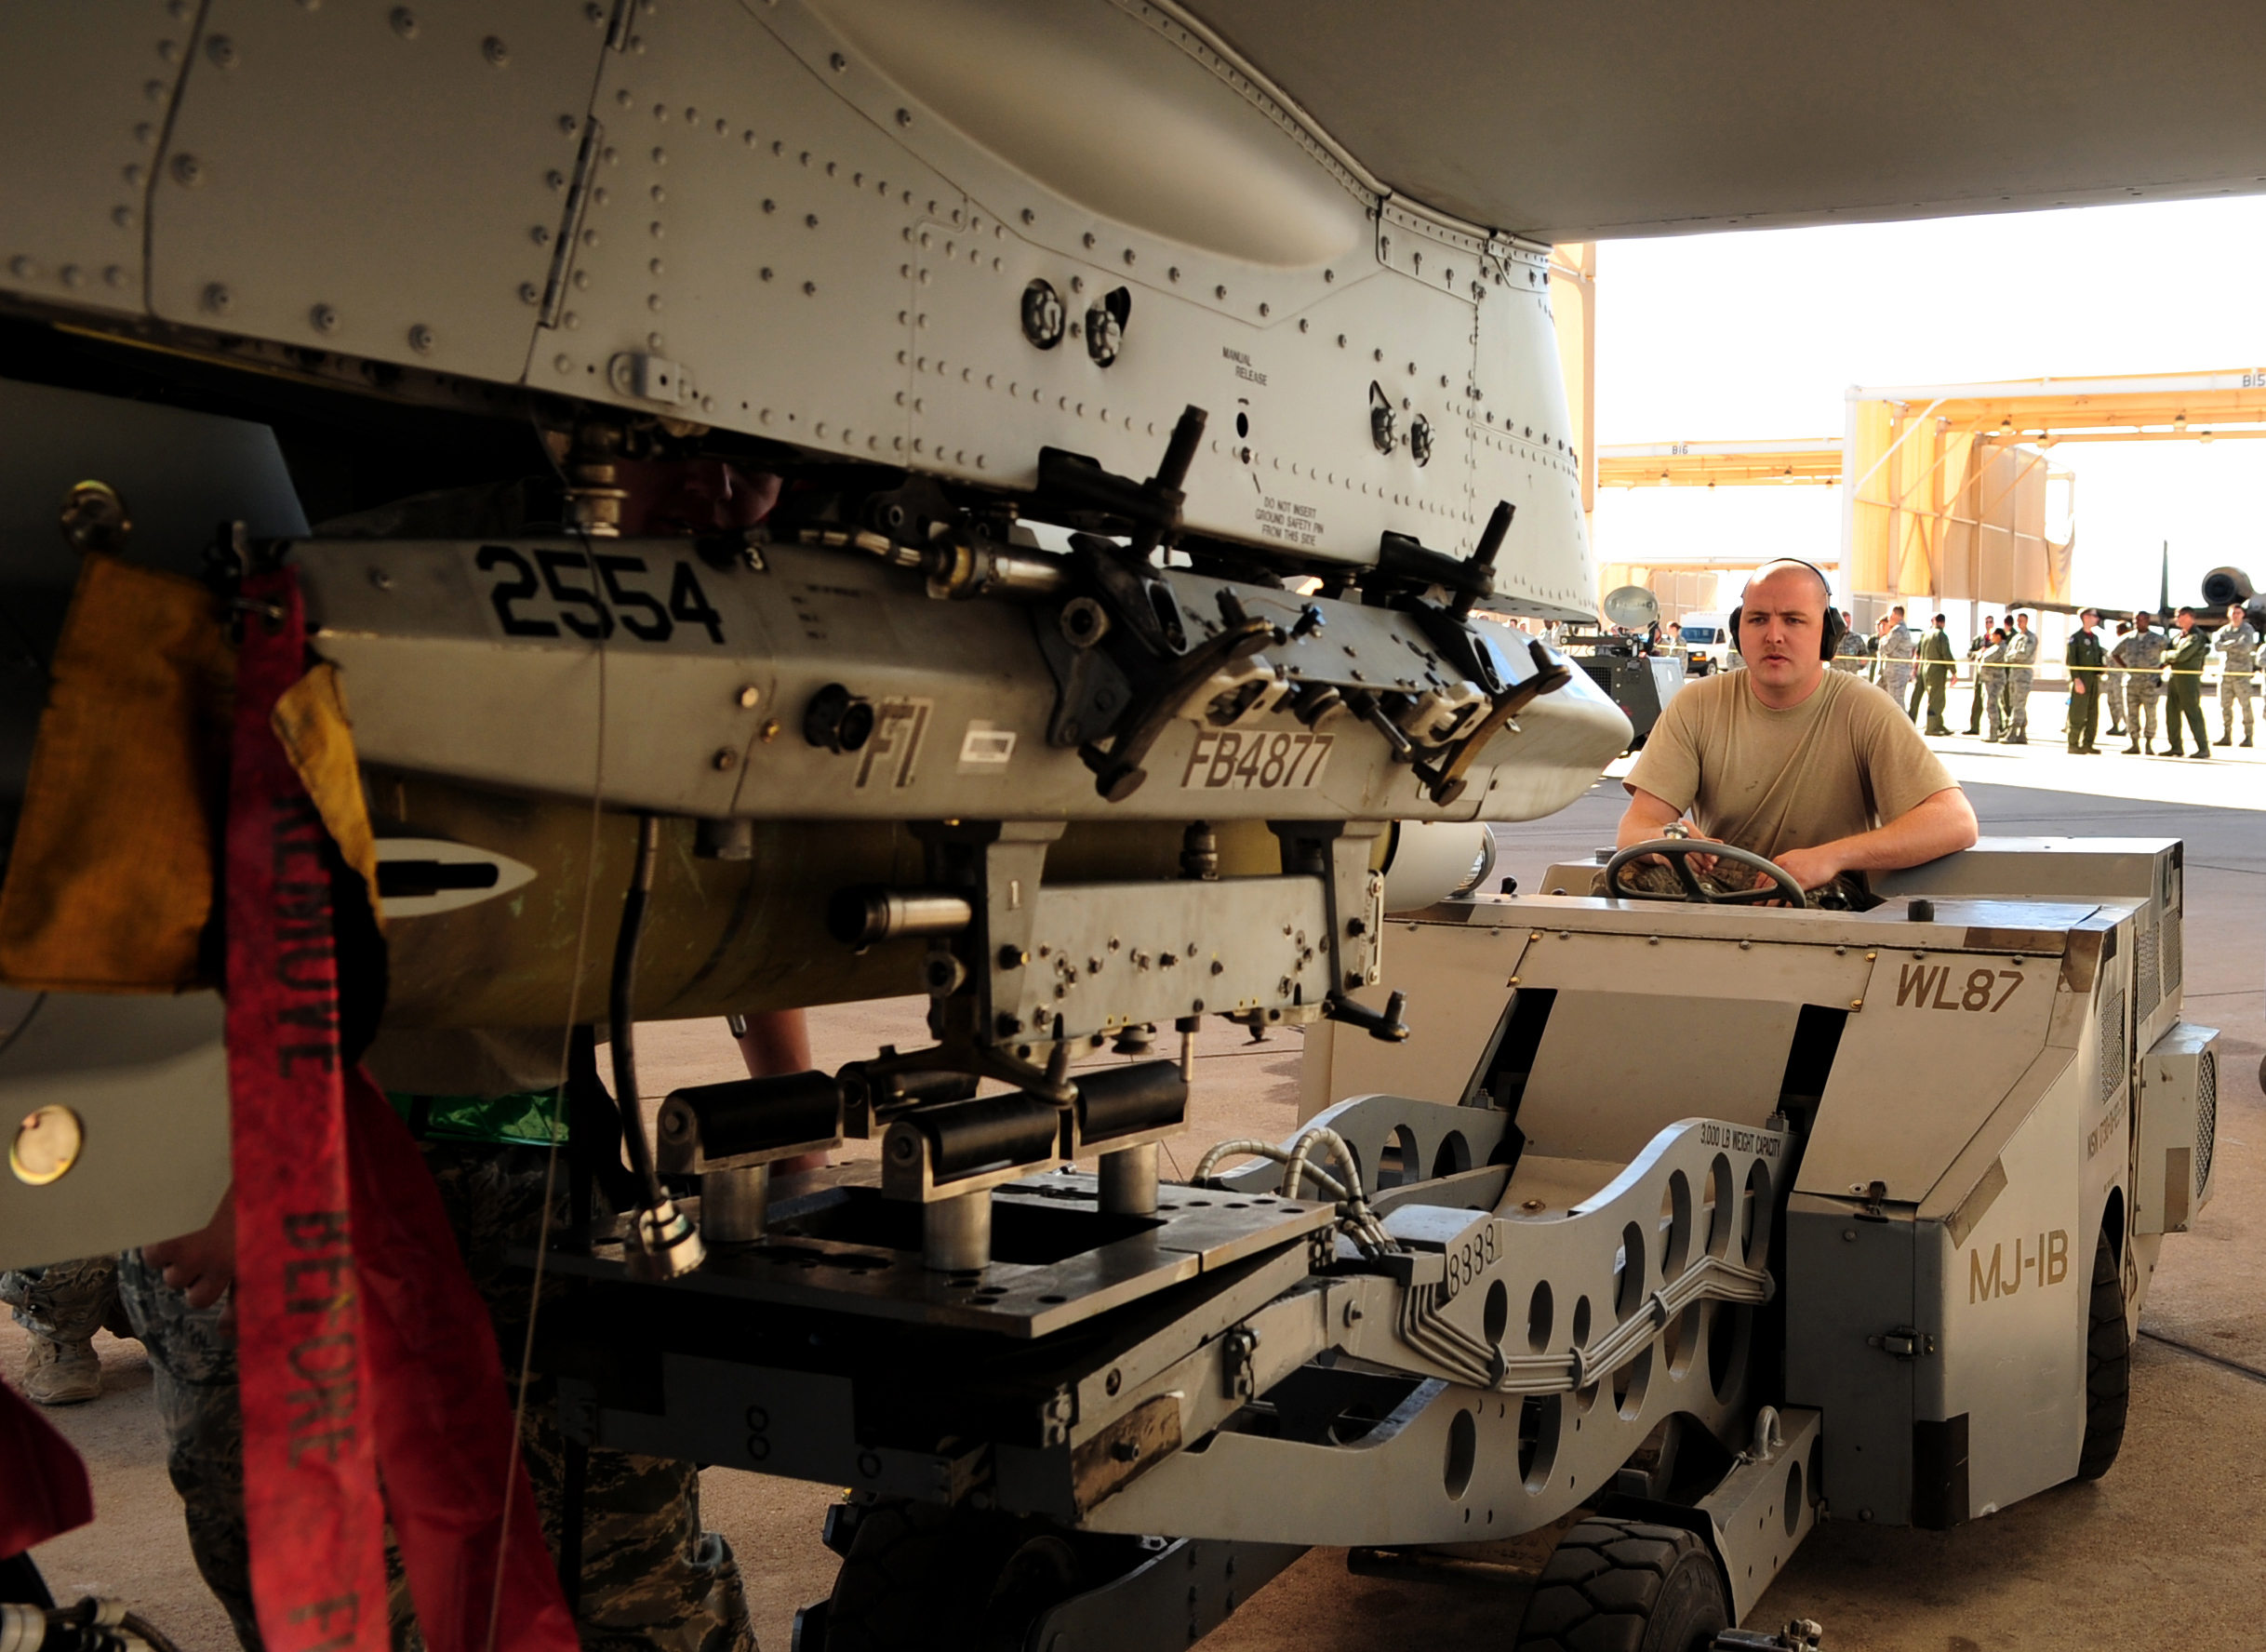
Vehicle / Manipulation Integration

Slide 44
Objective
Command and control the contact interface between the payload and target.
Specifically control how the two touching bodies apply constraint wrenches to each other as well as how the bodies freely twist relative to each other.
Implemented using screw
theory.
  wrench of constraint
  twist of freedom

Slide 45
Objective
Simultaneously control contact forces and position.
Implemented using screw theory.
  wrench of constraint
  twist of freedom

Slide 46
Terminology
twist
  an instantaneous motion
  can always be represented as a rotation about a line in space, coupled with a translation along that line
₀h₁
₀ω₁
{⁰S¹ ; ⁰S¹_{0L}}

Slide 47
Terminology
wrench
  a force / torque state
  can always be represented as a force along a line in space, coupled with a torque about that line
h_{f}
f
{S_{f} ; S_{f_0L}}

Slide 48
Terminology
When a body is in contact with the environment,
  twists of freedom are the still achievable motions
  ₀ω₁ {⁰S¹ ; ⁰S¹_{0L}+ ₀h₁ ⁰S¹} twist of freedom
  wrenches of constraint are the contact force and torque that will generate no motion of the body
  f {S_{f} ; S_{f_0L} + h_{f} S_{f}} wrench of constraint
  wrenches of constraint are reciprocal to the twists of freedom
  ⁰S¹ ⋅ (S_{f_0L} + h S_{f}) + S_{f} ⋅ (⁰S¹_{0L}+ h ⁰S¹) = 0

Slide 49
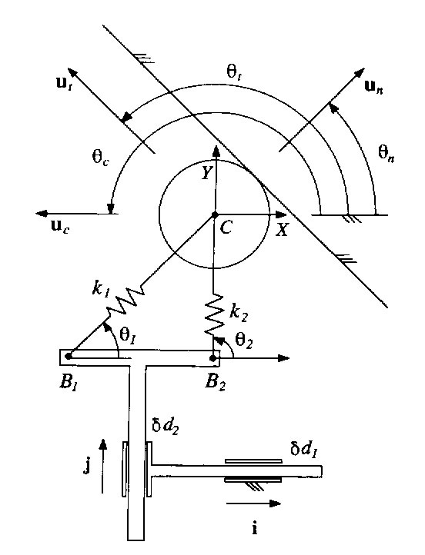
Kinestatic Control
Introductory Example
The compliance matrix is a key part of the Kinesthetic Control approach.

Slide 50
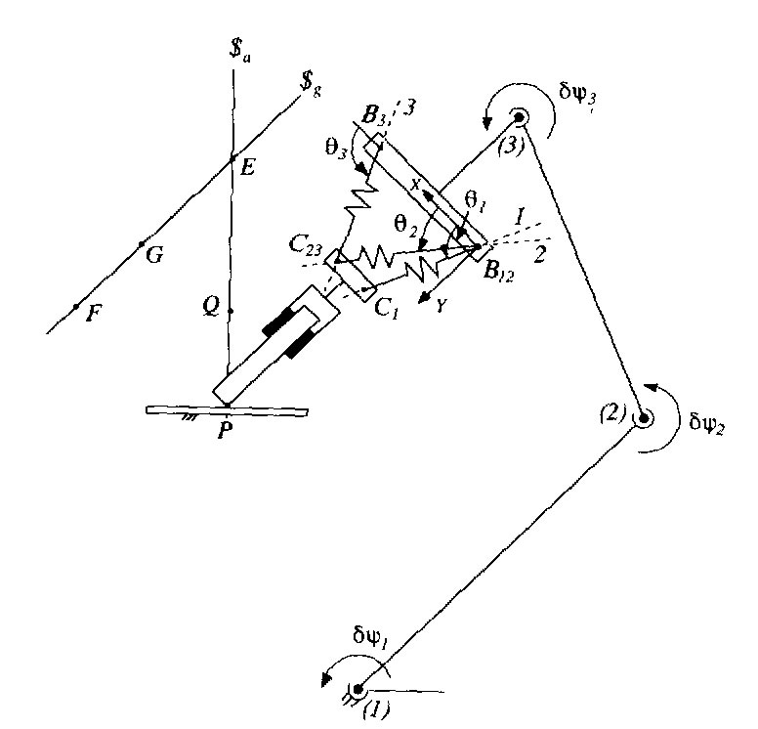
Kinestatic Control
Introductory Example
body 1
compliant
element
Compliance is introduced between the end of the robot (body 1) and the body that contacts the environment (body 2).
We can determine the compliance matrix-
  this relates the change of the contact wrench to the change in the relative pose between bodies 1 and 2
body 2

Slide 51
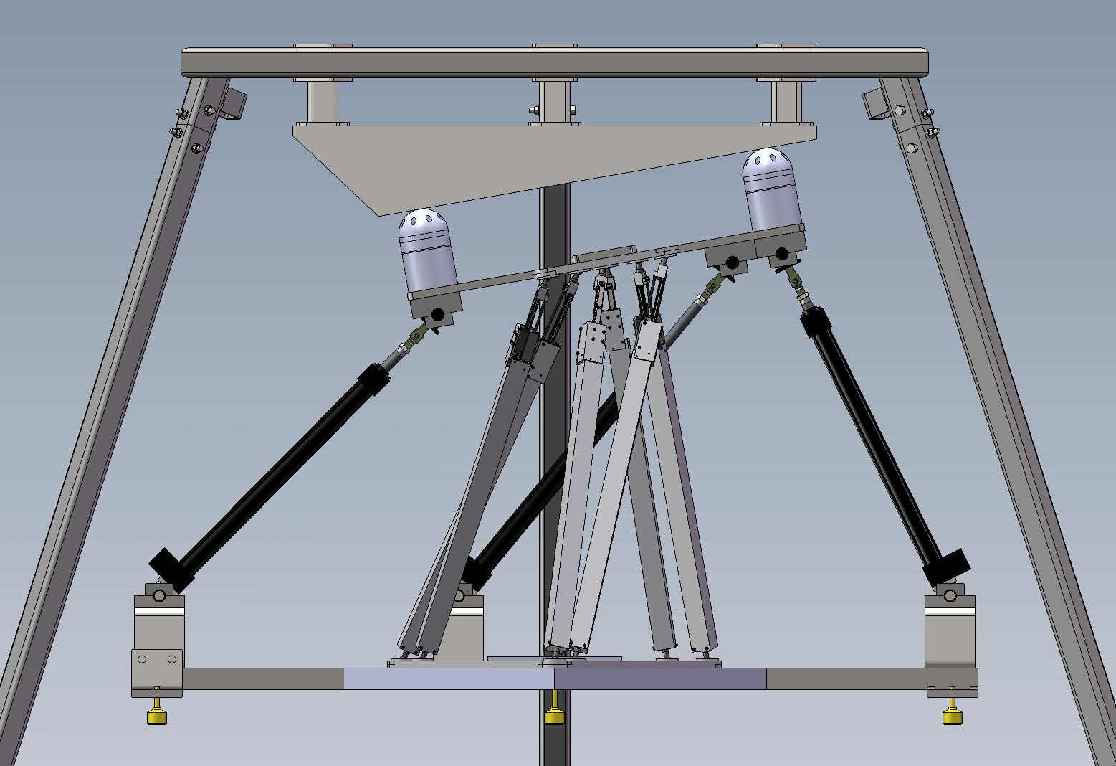
Testbed for this Work

Slide 52
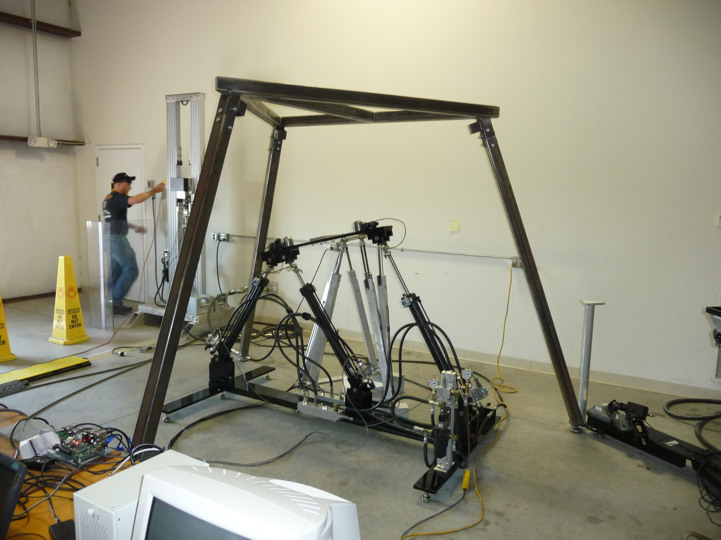
Testbed for this Work

Slide 53
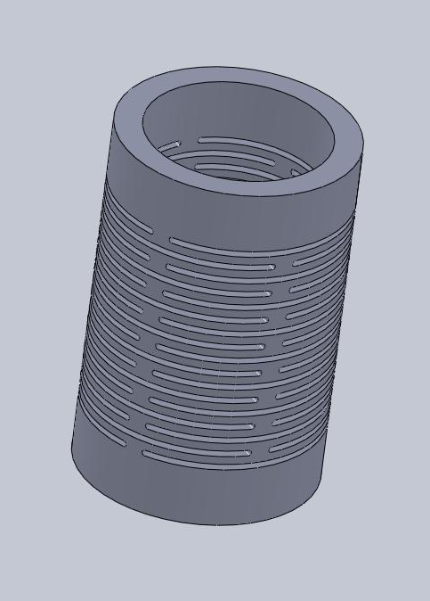
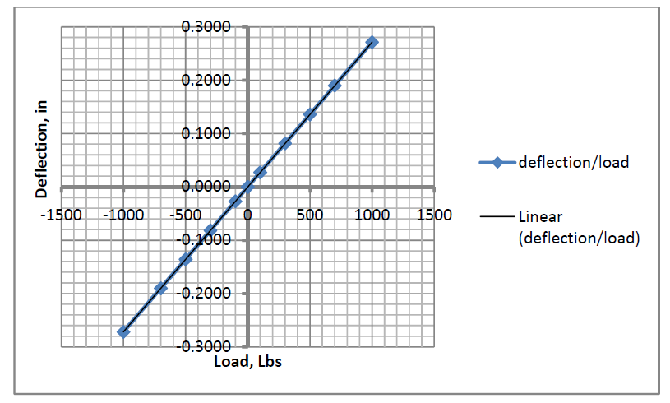
Spring Elements

Slide 54
Sensed Inputs
K matrix evaluated at each instant
y₂
x₂
y₁
f₁
f₃
f₂
x₁

Slide 55
Control Schema
high-level assembly task supervisor
  develops overall assembly plan
  maintains an instantaneous model of available twists of motion and current wrenches of constraint
  based on current step of assembly operation, generates a desired motion twist and a desired contact wrench
mid-level explicit kinestatic controller
  via kinestatic control, actuator forces are determined which will achieve the desired motion twist and the desired contact wrench
low-level force controller
  conventional force control of individual actuators

Slide 56
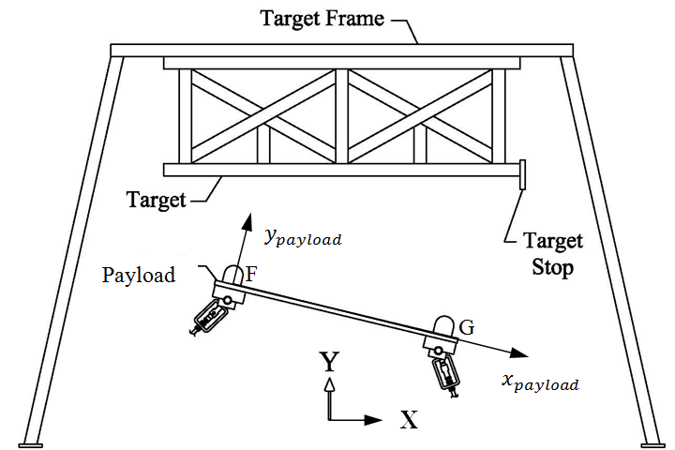
Task
Target
Tangency line
Case 1
F
G
payload
Case 2
payload
F
G
Target
Case 0
Tangency line
Case 3
target
tangency line
F
G
payload

Slide 57
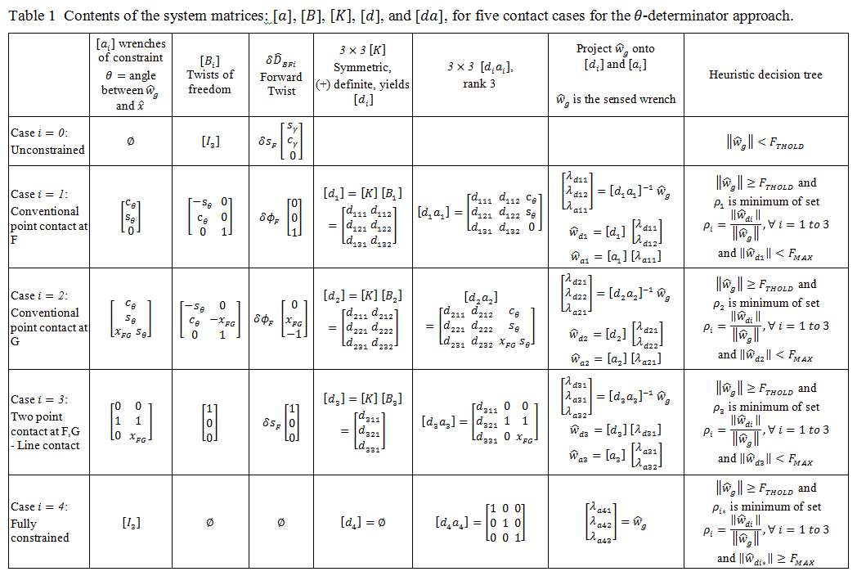
desired twist for case i
decompose the sensed wrench
deflection wrenches for case i
set of wrenches that span space

Slide 58
Target
Tangency line
F
G
payload
desired twist for case i
decompose the sensed wrench
deflection wrenches for case i
set of wrenches that span space

Slide 59
payload
F
G
Target
Tangency line
desired twist for case i
decompose the sensed wrench
deflection wrenches for case i
set of wrenches that span space

Slide 60
target
tangency line
F
G
payload
desired twist for case i
decompose the sensed wrench
deflection wrenches for case i
set of wrenches that span space

Slide 61

Summary
at each instant
  three leg lengths are known
  force in each leg is known
  calculate net wrench,
  determine twists of freedom and
  use K matrix to get deflection
  wrenches
  project net wrench on wrenches of
  constraint and deflection wrenches
  consider each of 5 contact cases
  and determine case based on
  heuristic rules
  select magnitudes for constraint wrench and deflection wrench to correct any error in contact wrench and to cause the desired twist
  decompose the net total desired wrench into individual leg forces and command the legs

Slide 62
Topics
History
  Autonomous navigation with static obstacles.
  Autonomous navigation in an urban environment.
  Application: Autonomous convoy operations.
  Application: Automated range clearance.
Direction of Research
  Manipulation.
  Vehicle performance.
  New research thrusts.

Slide 63
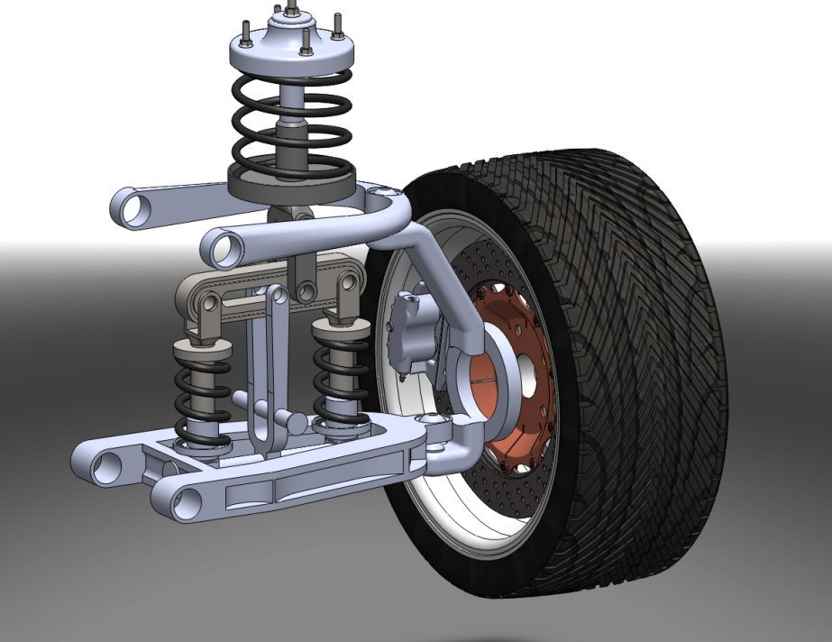
Adjustable Stiffness Suspension Mechanism
Objective
  Develop a suspension system that isolates a car body from road disturbances by mechanically adjusting it’s effective stiffness.
Approach
  Application of a recently
  designed variable stiffness
  mechanism.

Slide 64
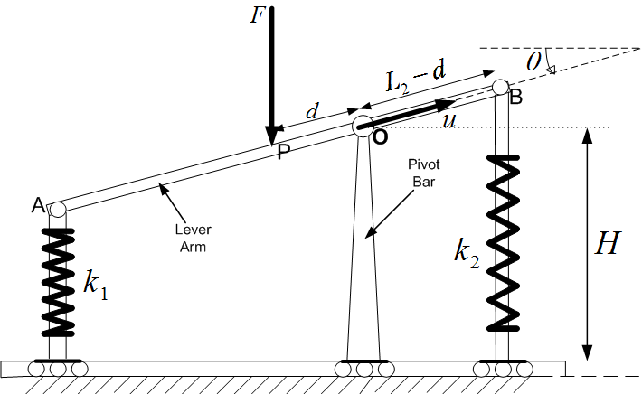
Variable Stiffness Mechanism
Schematic: Variable Stiffness Mechanism

Slide 65
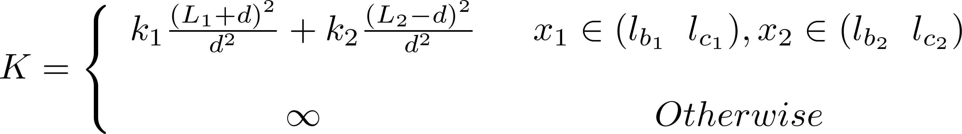
Effective Stiffness

Slide 66
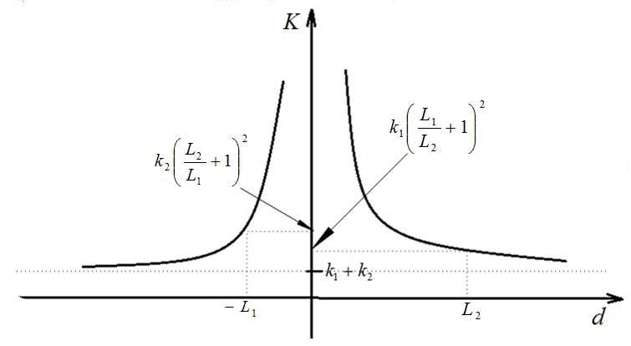
Plot of Effective Stiffness
Aspect Ratio

Slide 67
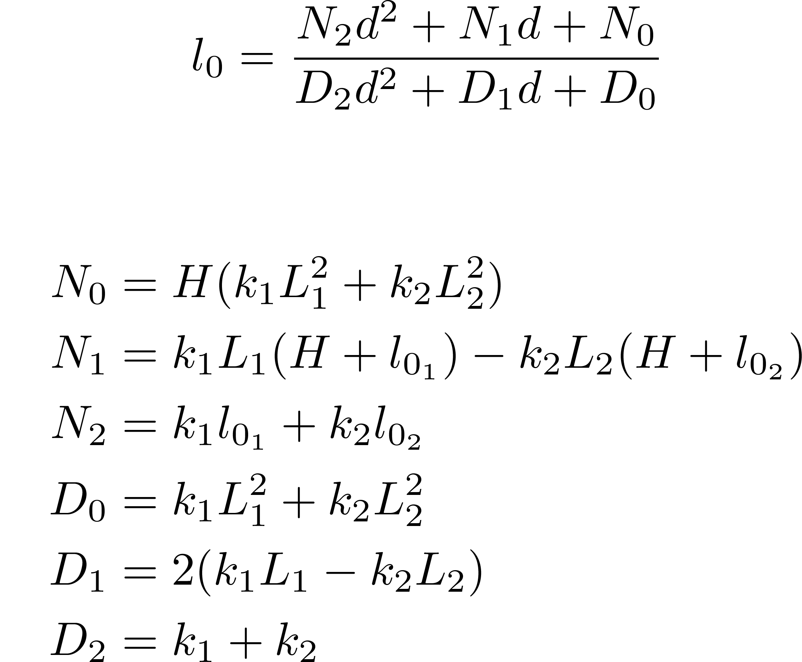
Determination of Free Length
Overall Free Length

Slide 68
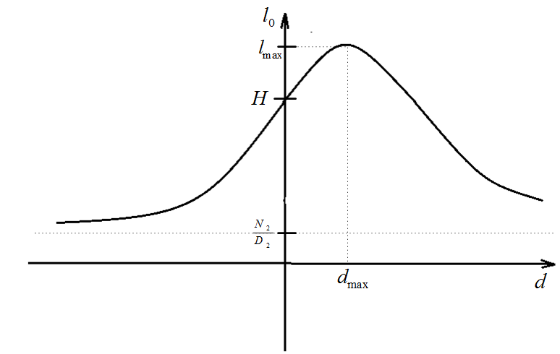
Plot of Overall Free Length

Slide 69
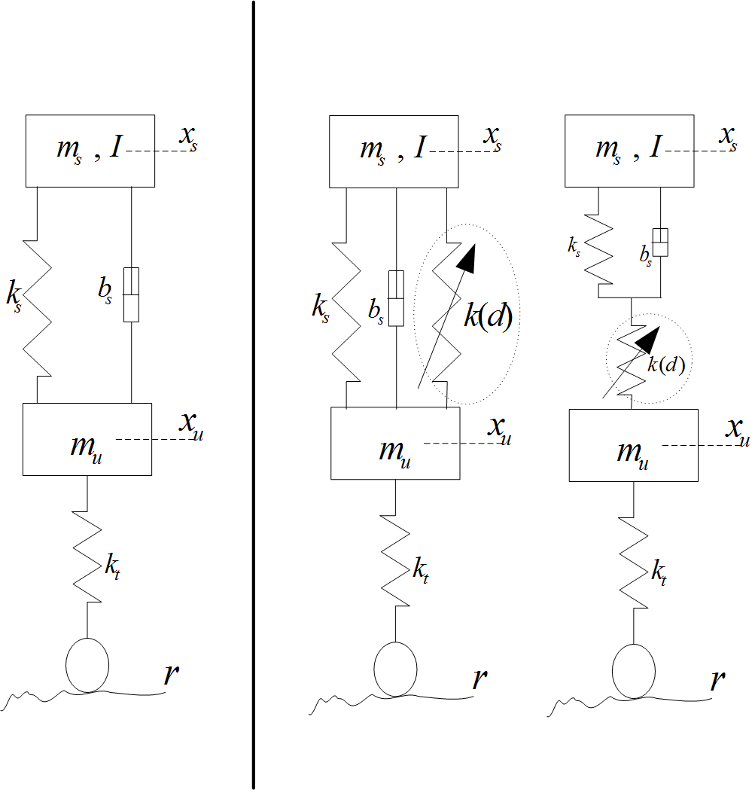
Application to Suspension System
Schematics: Variable Stiffness Suspension Mechanism

Slide 70
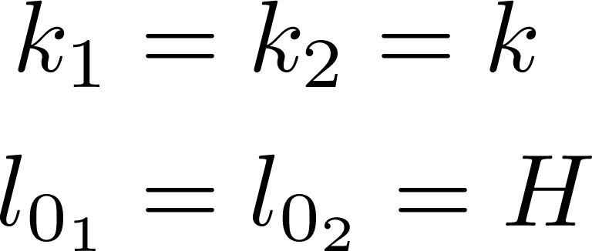
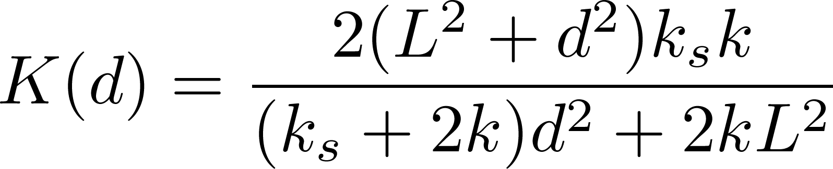

Parameters
Effective Stiffness
Overall Free Length

Slide 71
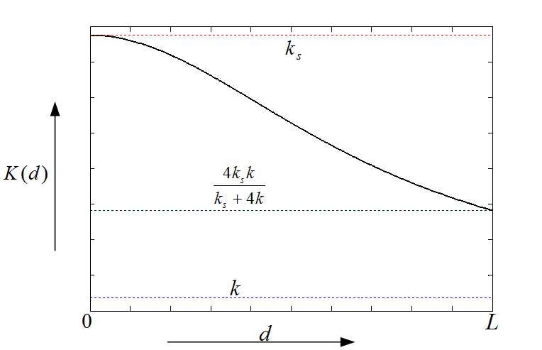
Plot of Effective Stiffness

Slide 72
Passive vs. Active System

Slide 73

Controller Design
ride comfort
suspension
deflection
road holding
H-infinity Design Block Interconnection Diagram

Slide 74



Performance Weights
  Ride Comfort
  Suspension Deflection
  Road Holding
(ISO 2631, 1997)

Slide 75

Discrete Event
Road bump at speed of 40 mph
(m)

Slide 76
Discrete Event – Time Domain Results
Road bump at speed of 40 mph
m/sec²
m
m

Slide 77

Discrete Event – Time Domain Results

Slide 78

New Design
Current Design

Slide 79



Slide 80

Conclusion
The performance of vehicle suspension can be improved by varying the stiffness of the suspension element.
Passive Variable Stiffness Suspension Mechanism improves the ride comfort but degrades the suspension deflection.
Active Variable Stiffness Suspension
Mechanism provided the best trade off
between Ride comfort, Suspension deflection
and Road holding.
Future work will be to optimize the design for
compactness.

Slide 81
Topics
History
  Autonomous navigation with static obstacles.
  Autonomous navigation in an urban environment.
  Application: Autonomous convoy operations.
  Application: Automated range clearance.
Direction of Research
  Manipulation.
  Vehicle performance.
  New research thrusts.

Slide 82
Research Direction
Image-based Estimation and Control
  Keeping objects in the field of view (FOV).
  Alternative guidance navigation & control for unmanned vehicle.
  Improved pose (position and orientation) estimation.
  Geo-location and geo-referencing using videos.
Intelligent Autonomy
  Human and machine interaction with shared intelligence.
  Intelligent control methods – e.g., actor critic, reinforcement learning, learn from experience.
Infrastructure Improvement to Aid Autonomy
  Peer to peer vehicle communication.
  “Smart” intersections.
Sensing
  tall grass problem

Slide 83

Thank You

